Slide 1
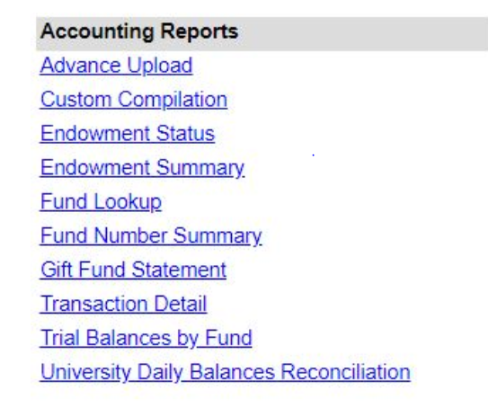
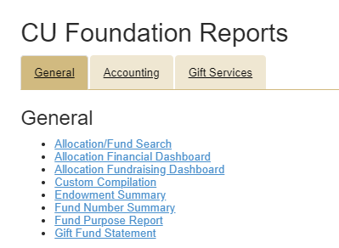
Report Matrix
Financial Edge Warehouse
Advancement Intelligence
*
New on AI
New on AI
New on AI
*No Live Training Opportunities will be offered on Accounting Specific Reports.
Notes:
Brian

